Slide 1

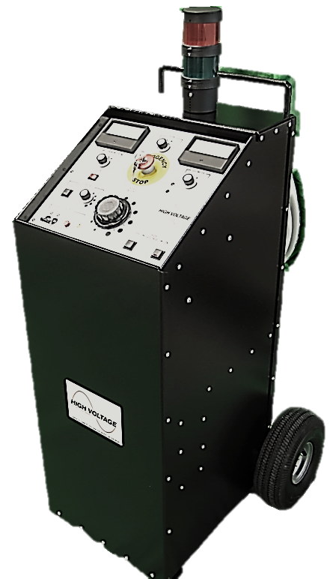
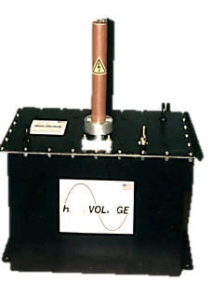
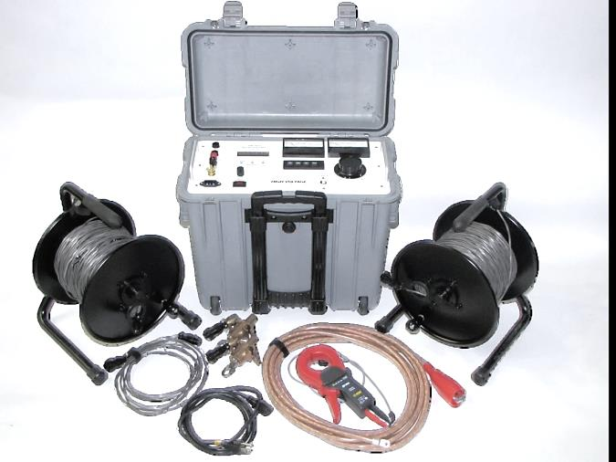
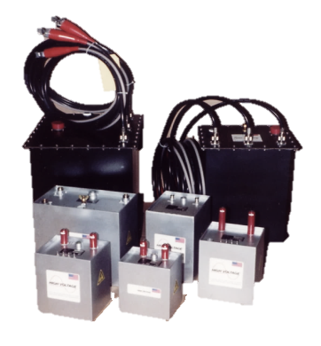
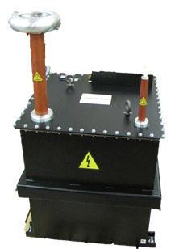
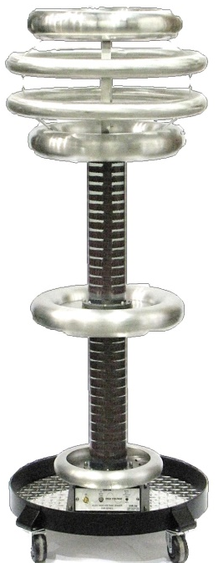
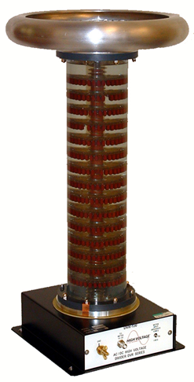
Other Products from HVI
FPA Series
Field Portable AC Testers
Ω-Check® Concentric Neutral Resistance Tester
OEM & Lab AC/DC HV
Supplies & Isolation Transformers
Intact neutrals are vital to the stability, reliability, & safety of a distribution system
DVR Series - HV AC/DC Dividers
Ideal for Mot/Gen Testing
FPA-12/066F
0 – 6 kVac @ 1 amp
0 – 12 kVac @ .5 amp
Fault Burn Mode
Isolated Return Guard
Shielded Output Cable
Models DVR-150
0-150 kV AC/DC
Models DVR-300
0-300 kV AC/DC
AC or DC Supplies
5 kV – 400 kV
1 kVA – 40 kVA

